Slide 1
Murach’s SQL Server 2022
Chapter 5
How to code summary queries

Slide 2
Objectives
Applied
Code summary queries that use the aggregate functions such as AVG, SUM, MIN, MAX, and COUNT.
Group and summarize data using aggregate functions and the GROUP BY and HAVING clauses.
Group and summarize data using the ROLLUP, CUBE, and GROUPING SETS operators and the OVER clause.
Knowledge
Describe summary queries.
Describe the differences between the HAVING clause and the WHERE clause.

Slide 3
The syntax of the aggregate functions
AVG([ALL|DISTINCT] expression)
SUM([ALL|DISTINCT] expression)
MIN([ALL|DISTINCT] expression)
MAX([ALL|DISTINCT] expression)
COUNT([ALL|DISTINCT] expression)
COUNT(*)

Slide 4
A summary query that counts unpaid invoices and calculates the total due
SELECT COUNT(*) AS NumberOfInvoices,
SUM(InvoiceTotal - PaymentTotal - CreditTotal)
AS TotalDue
FROM Invoices
WHERE InvoiceTotal - PaymentTotal - CreditTotal > 0;

Slide 5
A summary query with COUNT(*), AVG, and SUM
SELECT 'After 7/1/2022' AS SelectionDate,
COUNT(*) AS NumberOfInvoices,
AVG(InvoiceTotal) AS AverageInvoiceAmount,
SUM(InvoiceTotal) AS TotalInvoiceAmount
FROM Invoices
WHERE InvoiceDate > '2022-07-01';

Slide 6
A summary query with MIN and MAX
SELECT 'After 7/1/2022' AS SelectionDate,
COUNT(*) AS NumberOfInvoices,
MAX(InvoiceTotal) AS HighestInvoiceTotal,
MIN(InvoiceTotal) AS LowestInvoiceTotal
FROM Invoices
WHERE InvoiceDate > '2022-07-01';

Slide 7
A summary query for non-numeric columns
SELECT MIN(VendorName) AS FirstVendor,
MAX(VendorName) AS LastVendor,
COUNT(VendorName) AS NumberOfVendors
FROM Vendors;

Slide 8
A summary query with the DISTINCT keyword
SELECT COUNT(DISTINCT VendorID) AS NumberOfVendors,
COUNT(VendorID) AS NumberOfInvoices,
AVG(InvoiceTotal) AS AverageInvoiceAmount,
SUM(InvoiceTotal) AS TotalInvoiceAmount
FROM Invoices
WHERE InvoiceDate > '2022-07-01';

Slide 9
The SELECT statement syntax with the GROUP BY and HAVING clauses
SELECT select_list
[FROM table_source]
[WHERE search_condition]
[GROUP BY group_by_list]
[HAVING search_condition]
[ORDER BY order_by_list]
What can be included in the SELECT clause when grouping is used
Aggregate functions
The columns used for grouping
Expressions that result in a constant value.

Slide 10
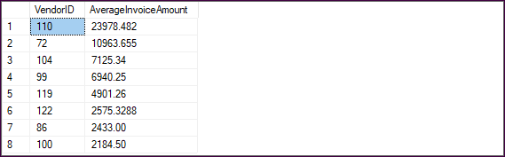
A summary query that calculates the average invoice amount by vendor
SELECT VendorID,
AVG(InvoiceTotal) AS AverageInvoiceAmount
FROM Invoices
GROUP BY VendorID
HAVING AVG(InvoiceTotal) > 2000
ORDER BY AverageInvoiceAmount DESC;

Slide 11
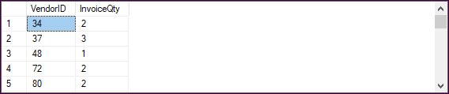
A summary query that counts the number of invoices by vendor (34 rows)
SELECT VendorID, COUNT(*) AS InvoiceQty
FROM Invoices
GROUP BY VendorID;

Slide 12
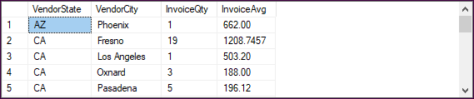
A summary query that groups by two columns (20 rows)
SELECT VendorState, VendorCity, COUNT(*) AS InvoiceQty,
AVG(InvoiceTotal) AS InvoiceAvg
FROM Invoices i
JOIN Vendors v
ON i.VendorID = v.VendorID
GROUP BY VendorState, VendorCity
ORDER BY VendorState, VendorCity;

Slide 13
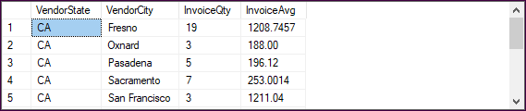
A summary query with a HAVING clause that limits the groups (12 rows)
SELECT VendorState, VendorCity, COUNT(*) AS InvoiceQty,
AVG(InvoiceTotal) AS InvoiceAvg
FROM Invoices i
JOIN Vendors v
ON i.VendorID = v.VendorID
GROUP BY VendorState, VendorCity
HAVING COUNT(*) >= 2
ORDER BY VendorState, VendorCity;

Slide 14
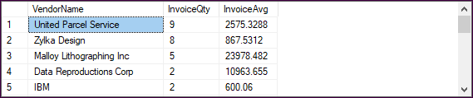
A summary query with a search condition in the HAVING clause (19 rows)
SELECT VendorName, COUNT(*) AS InvoiceQty,
AVG(InvoiceTotal) AS InvoiceAvg
FROM Vendors JOIN Invoices
ON Vendors.VendorID = Invoices.VendorID
GROUP BY VendorName
HAVING AVG(InvoiceTotal) > 500
ORDER BY InvoiceQty DESC;

Slide 15
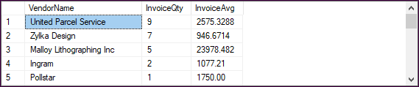
A summary query with a search condition in the WHERE clause (20 rows)
SELECT VendorName, COUNT(*) AS InvoiceQty,
AVG(InvoiceTotal) AS InvoiceAvg
FROM Vendors JOIN Invoices
ON Vendors.VendorID = Invoices.VendorID
WHERE InvoiceTotal > 500
GROUP BY VendorName
ORDER BY InvoiceQty DESC;

Slide 16
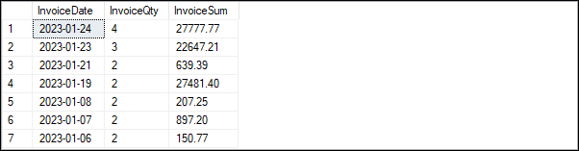
A summary query with a compound condition in the HAVING clause
SELECT InvoiceDate, COUNT(*) AS InvoiceQty,
SUM(InvoiceTotal) AS InvoiceSum
FROM Invoices
GROUP BY InvoiceDate
HAVING InvoiceDate BETWEEN '2023-01-01' AND '2023-01-31'
AND COUNT(*) > 1
AND SUM(InvoiceTotal) > 100
ORDER BY InvoiceDate DESC;
The result set

Slide 17
The same query coded with a WHERE clause
SELECT InvoiceDate, COUNT(*) AS InvoiceQty,
SUM(InvoiceTotal) AS InvoiceSum
FROM Invoices
WHERE InvoiceDate BETWEEN '2023-01-01' AND '2023-01-31'
GROUP BY InvoiceDate
HAVING COUNT(*) > 1
AND SUM(InvoiceTotal) > 100
ORDER BY InvoiceDate DESC;
The same result set

Slide 18
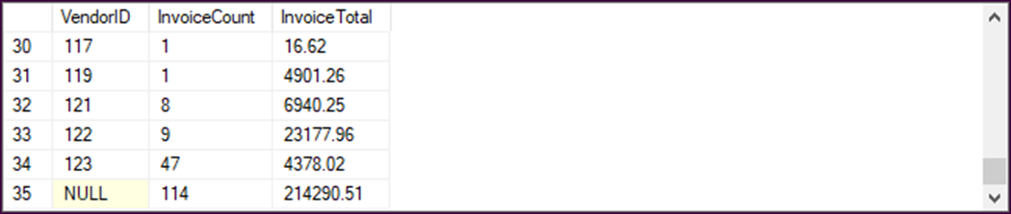
The ROLLUP operator in a summary query with a final summary row
SELECT VendorID, COUNT(*) AS InvoiceCount,
SUM(InvoiceTotal) AS InvoiceTotal
FROM Invoices
GROUP BY ROLLUP(VendorID);
Another way to code the GROUP BY clause
GROUP BY VendorID WITH ROLLUP

Slide 19
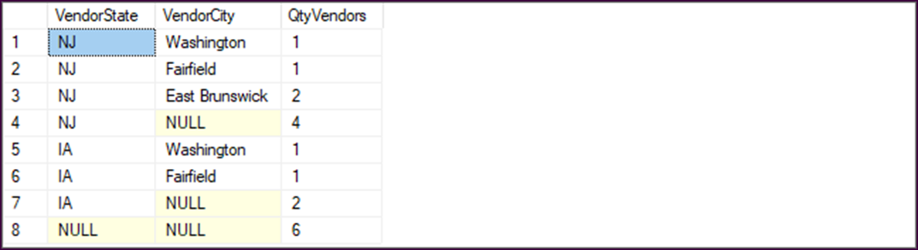
A summary query with a summary row for each grouping level
SELECT VendorState, VendorCity, COUNT(*) AS QtyVendors
FROM Vendors
WHERE VendorState IN ('IA', 'NJ') GROUP BY ROLLUP(VendorState, VendorCity)
ORDER BY VendorState DESC, VendorCity DESC;
Another way to code the GROUP BY clause
GROUP BY VendorState, VendorCity WITH ROLLUP

Slide 20
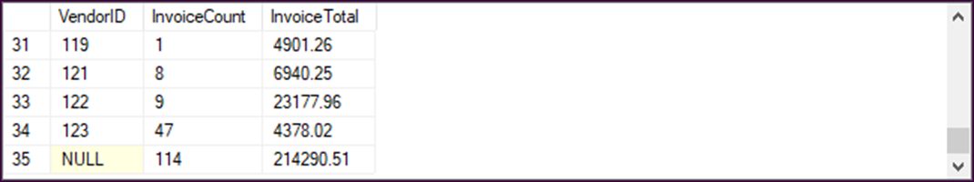
The CUBE operator in a summary query with a final summary row
SELECT VendorID, COUNT(*) AS InvoiceCount,
SUM(InvoiceTotal) AS InvoiceTotal
FROM Invoices
GROUP BY CUBE(VendorID);
Another way to code the GROUP BY clause
GROUP BY VendorID WITH CUBE

Slide 21
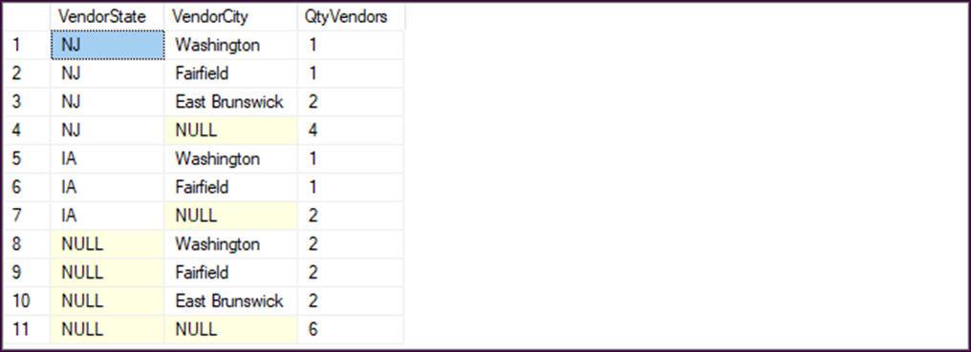
A summary query with a summary row for each set of groups
SELECT VendorState, VendorCity, COUNT(*) AS QtyVendors FROM Vendors WHERE VendorState IN ('IA', 'NJ') GROUP BY CUBE (VendorState, VendorCity) ORDER BY VendorState DESC, VendorCity DESC;
Another way to code the GROUP BY clause
GROUP BY VendorState, VendorCity WITH CUBE

Slide 22
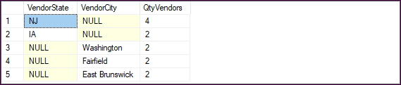
A summary query with two groups
SELECT VendorState, VendorCity, COUNT(*) AS QtyVendors
FROM Vendors
WHERE VendorState IN ('IA', 'NJ')
GROUP BY GROUPING SETS(VendorState, VendorCity)
ORDER BY VendorState DESC, VendorCity DESC;

Slide 23
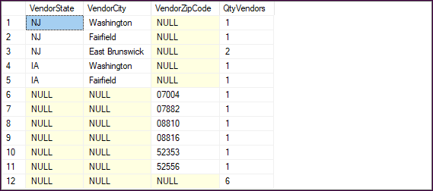
A summary query with a composite grouping
SELECT VendorState, VendorCity, VendorZipCode,
COUNT(*) AS QtyVendors
FROM Vendors
WHERE VendorState IN ('IA', 'NJ')
GROUP BY GROUPING SETS((VendorState, VendorCity),
VendorZipCode, ())
ORDER BY VendorState DESC, VendorCity DESC;

Slide 24
A summary query with a group that uses the ROLLUP operator
GROUP BY GROUPING SETS(ROLLUP(VendorState, VendorCity),
VendorZipCode)

Slide 25
The syntax of the OVER clause
aggregate_function OVER ([partition_by_clause]
[order_by_clause])

Slide 26
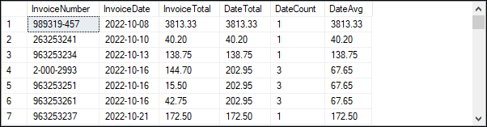
A query that groups the summary data by date
SELECT InvoiceNumber, InvoiceDate, InvoiceTotal,
SUM(InvoiceTotal) OVER (PARTITION BY InvoiceDate) AS
DateTotal,
COUNT(InvoiceTotal) OVER (PARTITION BY InvoiceDate) AS
DateCount,
AVG(InvoiceTotal) OVER (PARTITION BY InvoiceDate) AS
DateAvg
FROM Invoices;

Slide 27
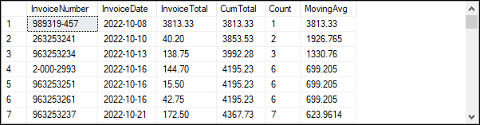
A query that calculates a cumulative total and moving average
SELECT InvoiceNumber, InvoiceDate, InvoiceTotal,
SUM(InvoiceTotal) OVER (ORDER BY InvoiceDate) AS CumTotal,
COUNT(InvoiceTotal) OVER (ORDER BY InvoiceDate) AS Count,
AVG(InvoiceTotal) OVER (ORDER BY InvoiceDate) AS MovingAvg
FROM Invoices;

Slide 28
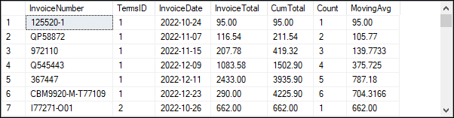
The same query grouped by TermsID
SELECT InvoiceNumber, TermsID, InvoiceDate, InvoiceTotal,
SUM(InvoiceTotal)
OVER (PARTITION BY TermsID ORDER BY InvoiceDate)
AS CumTotal,
COUNT(InvoiceTotal)
OVER (PARTITION BY TermsID ORDER BY InvoiceDate)
AS Count,
AVG(InvoiceTotal)
OVER (PARTITION BY TermsID ORDER BY InvoiceDate)
AS MovingAvg
FROM Invoices;

